Slide 1
Implementation and physical design of 8/4-bit signed divider
Under the guidance of:
Mr. MOHAMMED ZAKIR HUSSAIN
Asst. Prof., ECED, MJCET
MOHAMMED ABDUR RAHMAN 1604-18-735-119
SYED MOIZ 1604-18-735-112
SHAIK MUSHARRAF ALI 1604-18-735-311

Slide 2
Agenda
Introduction
Problem statement
Objective of the Project
Design Methodology
Conclusion
Future scope

Slide 3
Introduction- Why ASICs?
ASICs are everywhere where there is a need for
Performance
Customization
Size
Latency
Some of the applications are
Computer Graphics and Digital Signal Processing.
Deep Learning and Data Mining
Satellite, Radar and related Communication processors
Microprocessors, Memories, Microcontrollers

Slide 4
PROBLEM STATEMENT
Problem statement 1:
Internet of Things (IoT) makes limitation on power consumption for sensors and portable devices.
Thus exact computation for division processes are not allowed due to the huge amount of power consumption.
To address these limitations, a low power division computing units is required.

Slide 5
PROBLEM STATEMENT -contd.
Problem statement 1 -contd.
In a typical program, an arithmetic unit produces thousands of division computations per second.
To compute and produce correct results, the ALU‘s division algorithms must be as effective as possible.
Existing dividers are good enough but they are used to perform ordinary unsigned division which result in the following cons:-
More power consumption
Large area
Less performance (Frequency)
More Latency

Slide 6
PROBLEM STATEMENT -contd.
Problem statement 2.
Usage of commercial electronic design automation (EDA) tools is not possible by an individual and also for start-up firms because of the following
Purchase cost
Maintenance
License renewal
NDA issues
Commercial process design kits (PDKs) are also expensive which individual or startup companies find it difficult to procure.

Slide 7
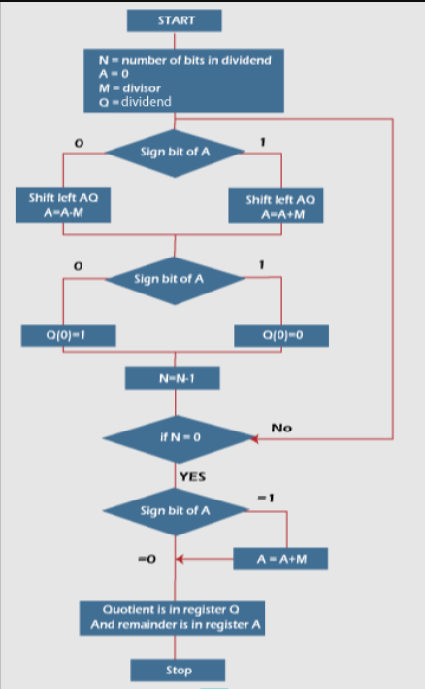
Non Restoring Algorithm

Slide 8
Objective of the project:
The objective of the project is to ensure power‐hungry division operations to a simple addition and subtraction process.
To overcome the above mentioned issues related to EDA and PDKs
Open source EDA Tools (free, no NDA)
Open PDKs(free, no NDA)
Design point of view to achieve
Less power consumption
Less area consumption
Efficiency (frequency)
*NDA=Non Disclosure Agreement.

Slide 9
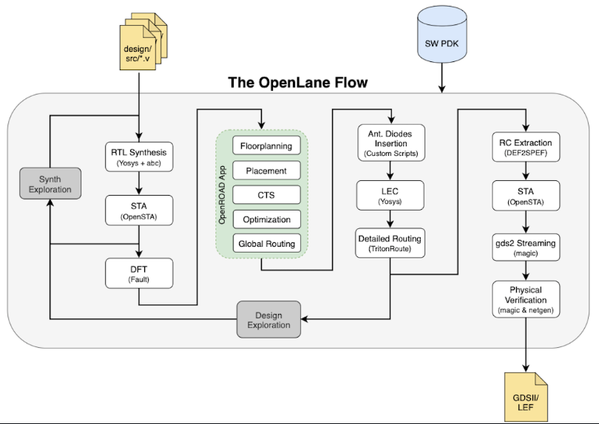
Physical Design Flowchart

Slide 10
DESIGN METHODOLOGY
Verilog HDL is used to develop Register transfer logic (RTL).
Open source EDA and open PDKs are used for complete flow from RTL-to-GDS2

Slide 11
FUTURE SCOPE
To explore the work flow of open source EDA tools.
To explore open source PDKs.

Slide 12
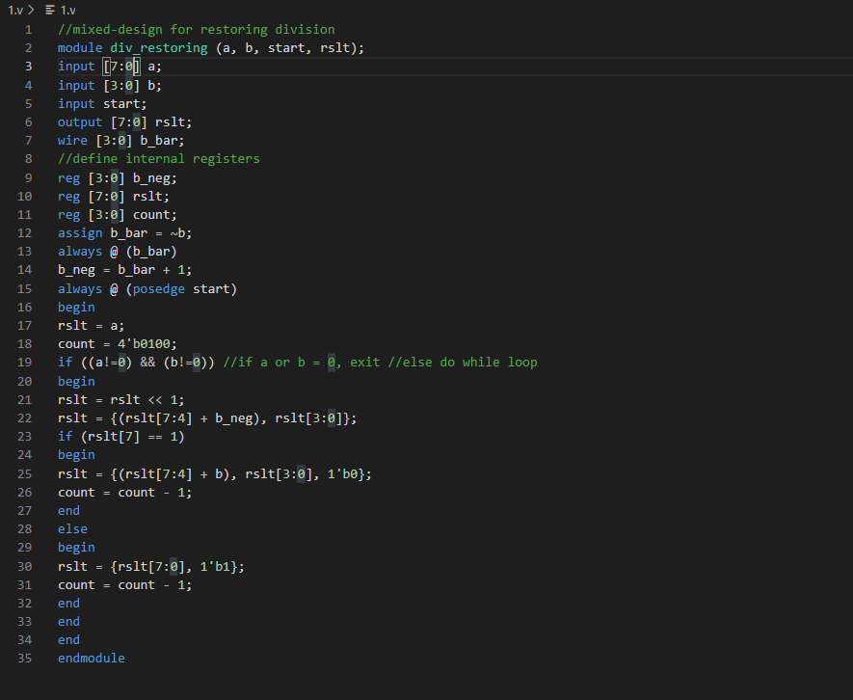
Verilog Codes

Slide 13
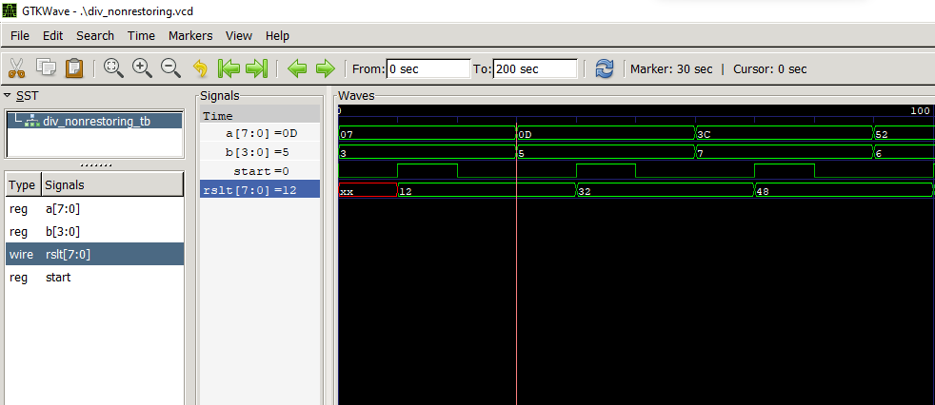
Simulation results

Slide 14
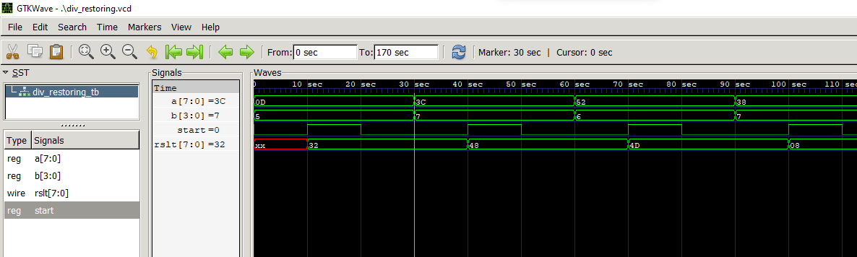
Simulation results contd.

Slide 15
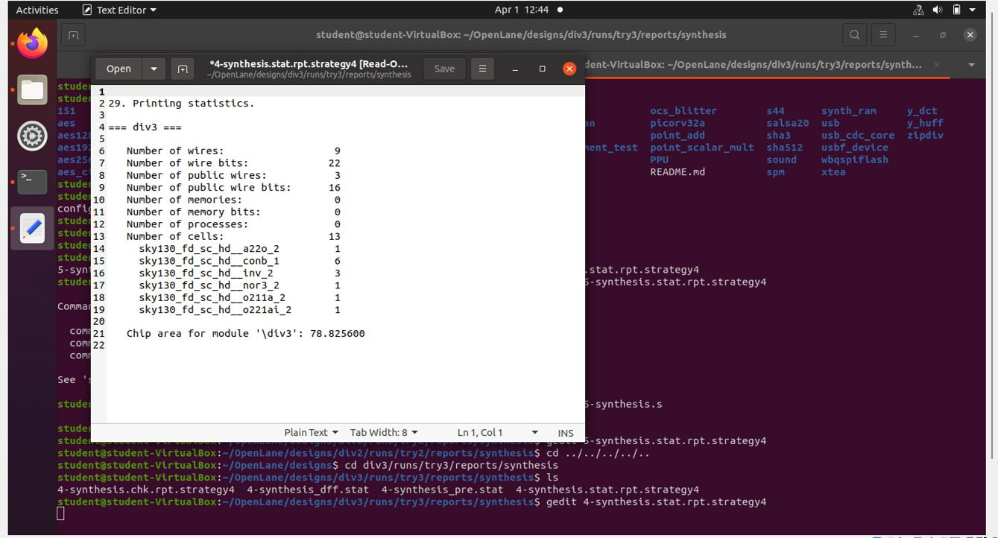
Statistics reports

Slide 16
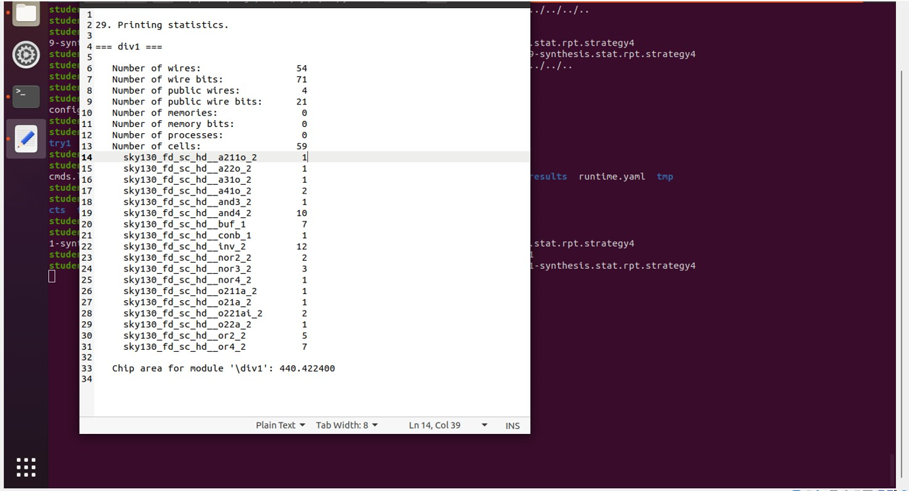
Statistics reports contd

Slide 17
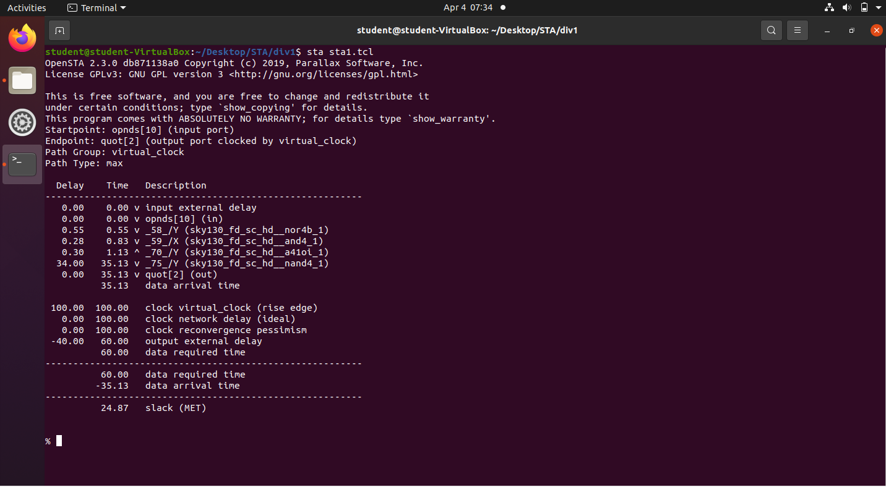
STA Result 1

Slide 18
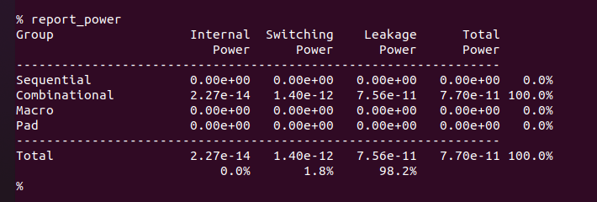
Power report 1

Slide 19
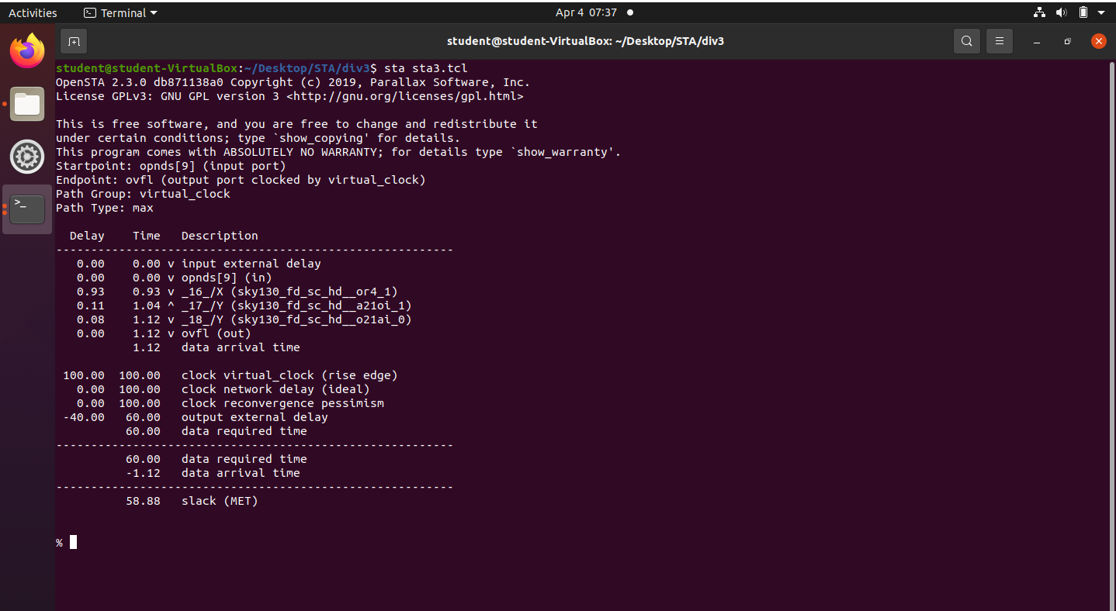
STA Result 2

Slide 20
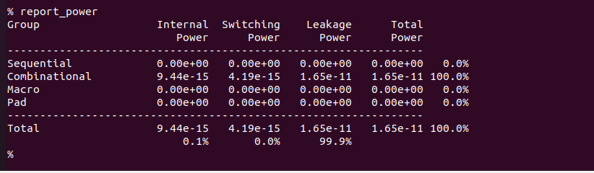
Power report 2

Slide 21
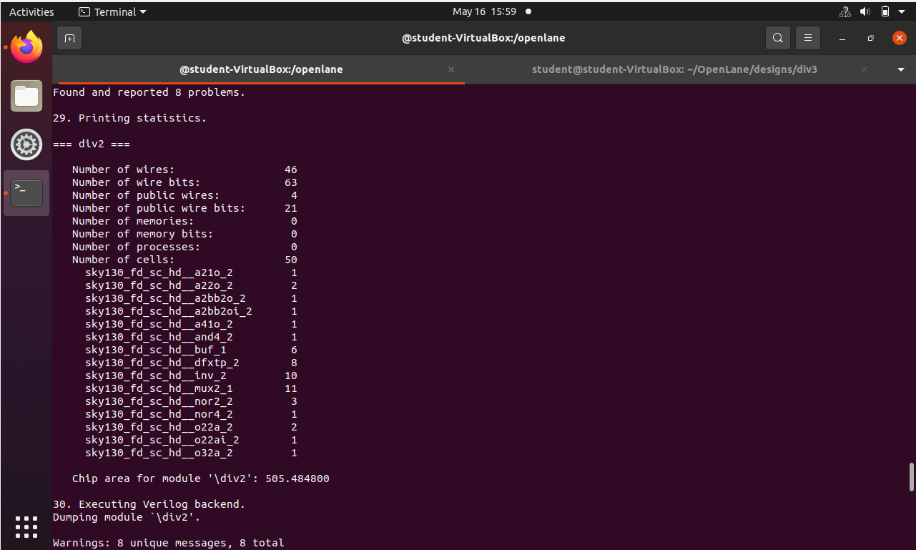
Synthesis – div2

Slide 22
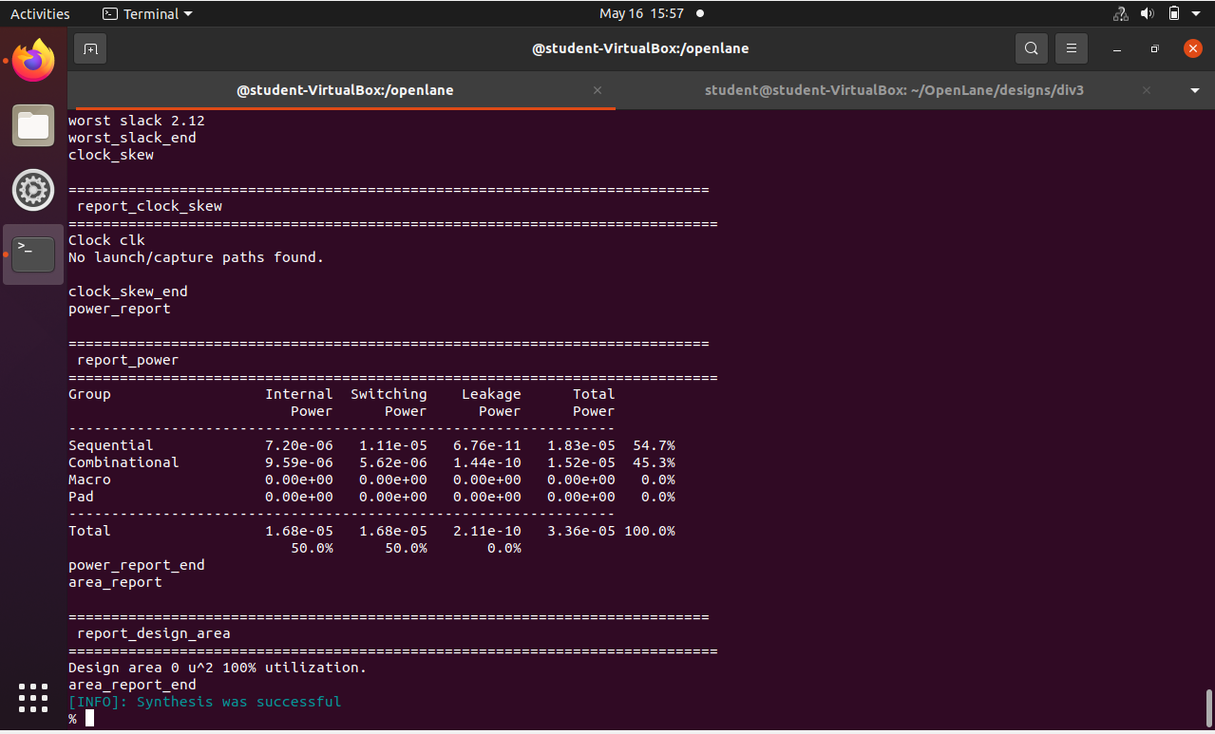
Synthesis – div2 contd.

Slide 23
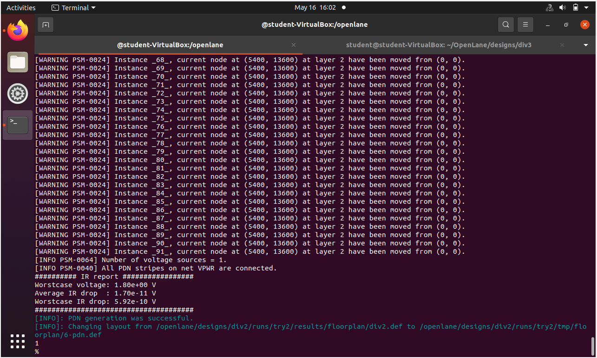
Floorplan – div2

Slide 24
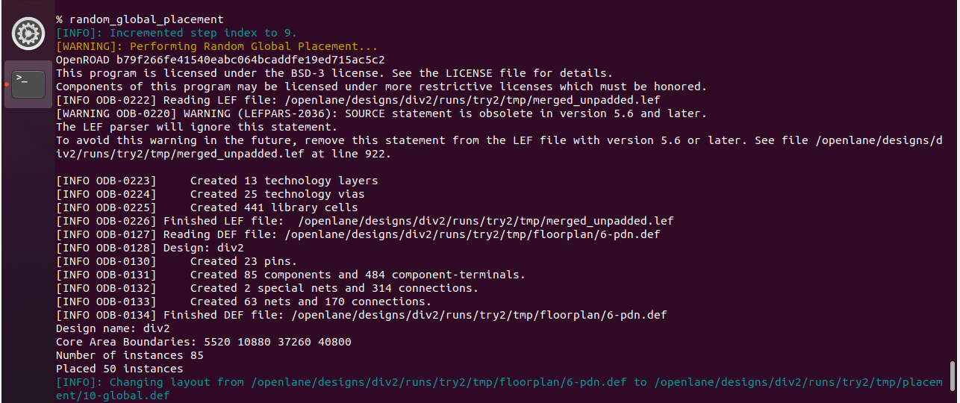
Placement – div2

Slide 25
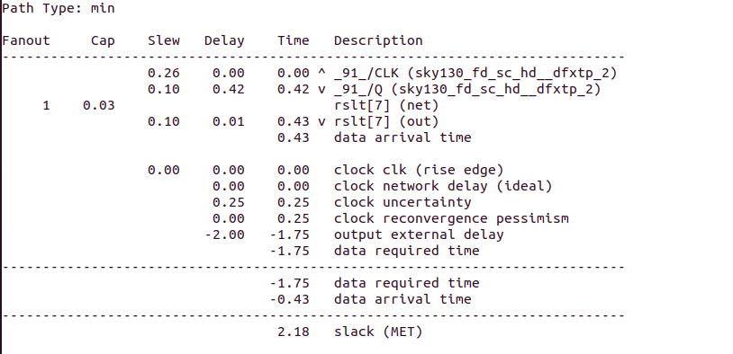
Placement – div2 contd..

Slide 26
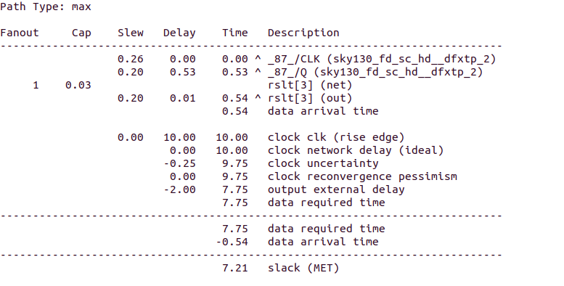
Placement – div2 contd..

Slide 27
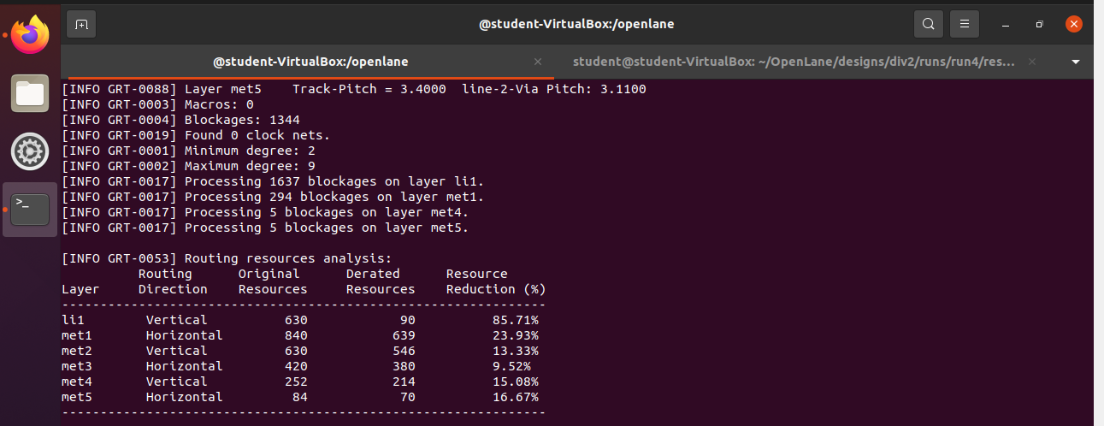
Routing – div2

Slide 28
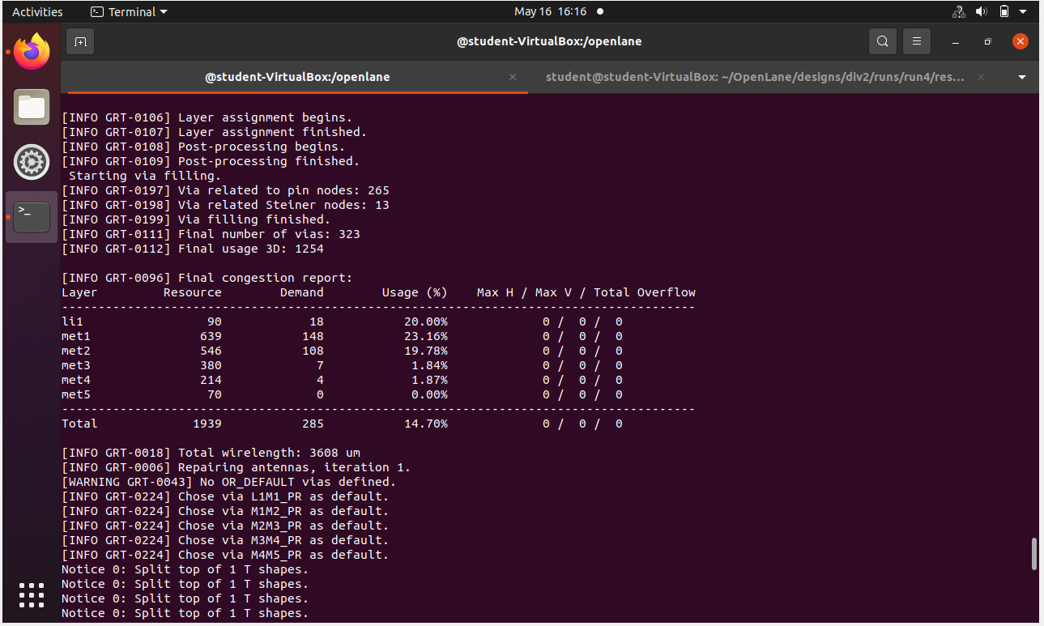
Routing – div2 contd..

Slide 29
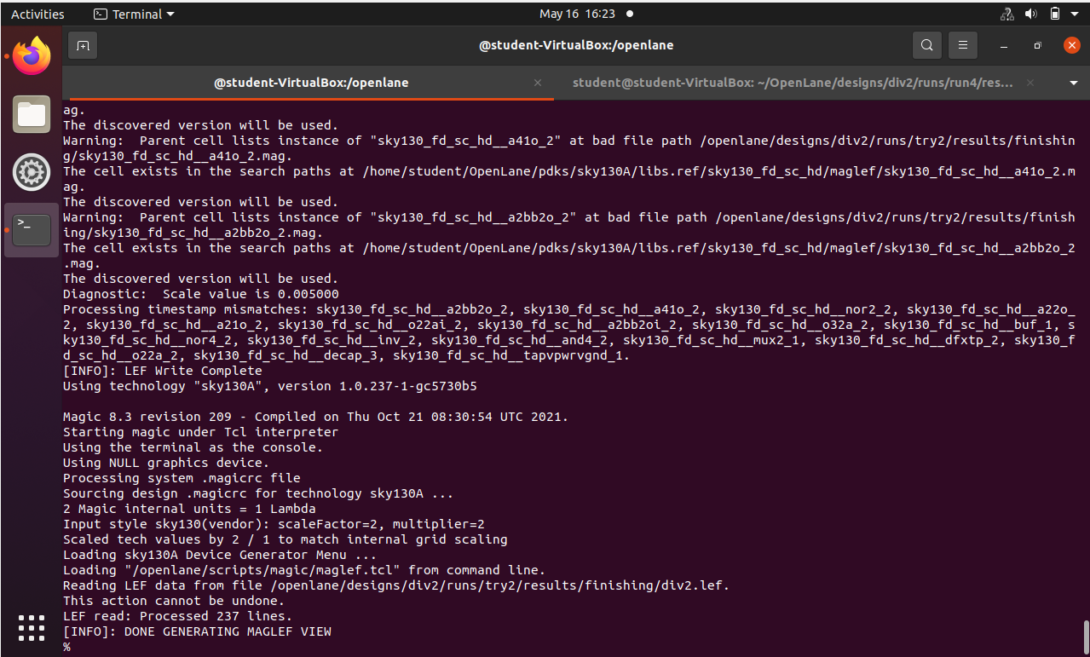
Magic – div2

Slide 30
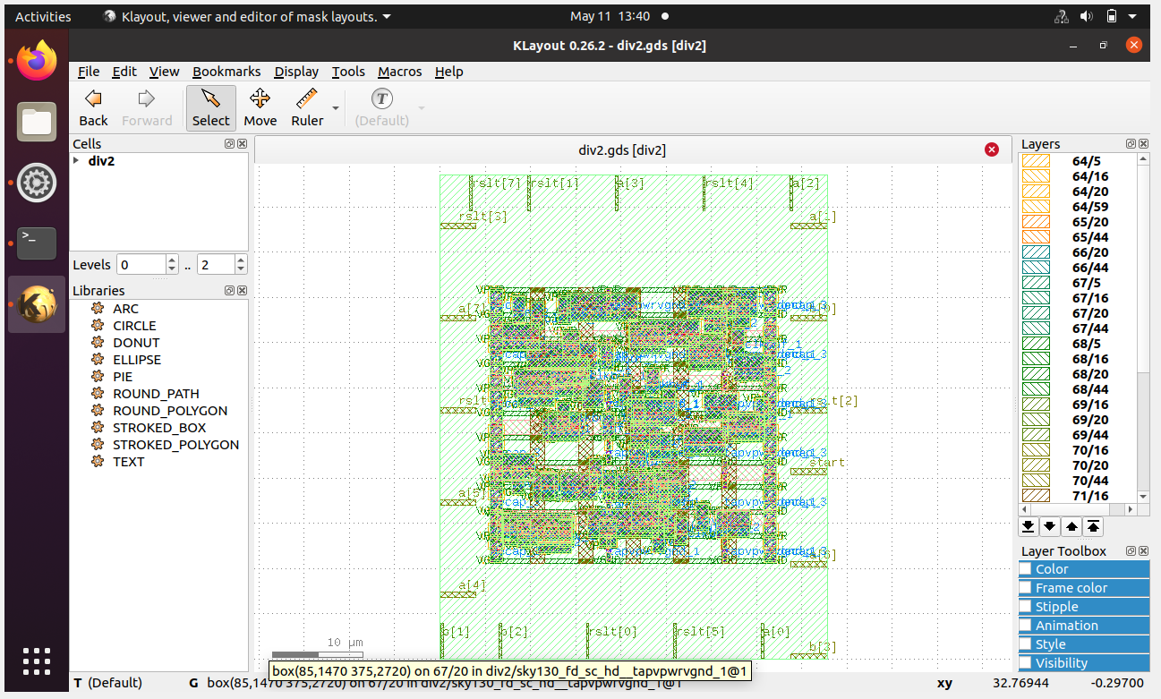
GDS-2 File – div2

Slide 31
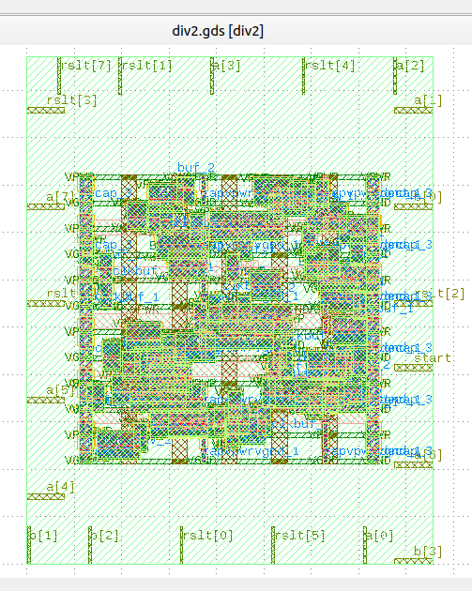
GDS - div2

Slide 32
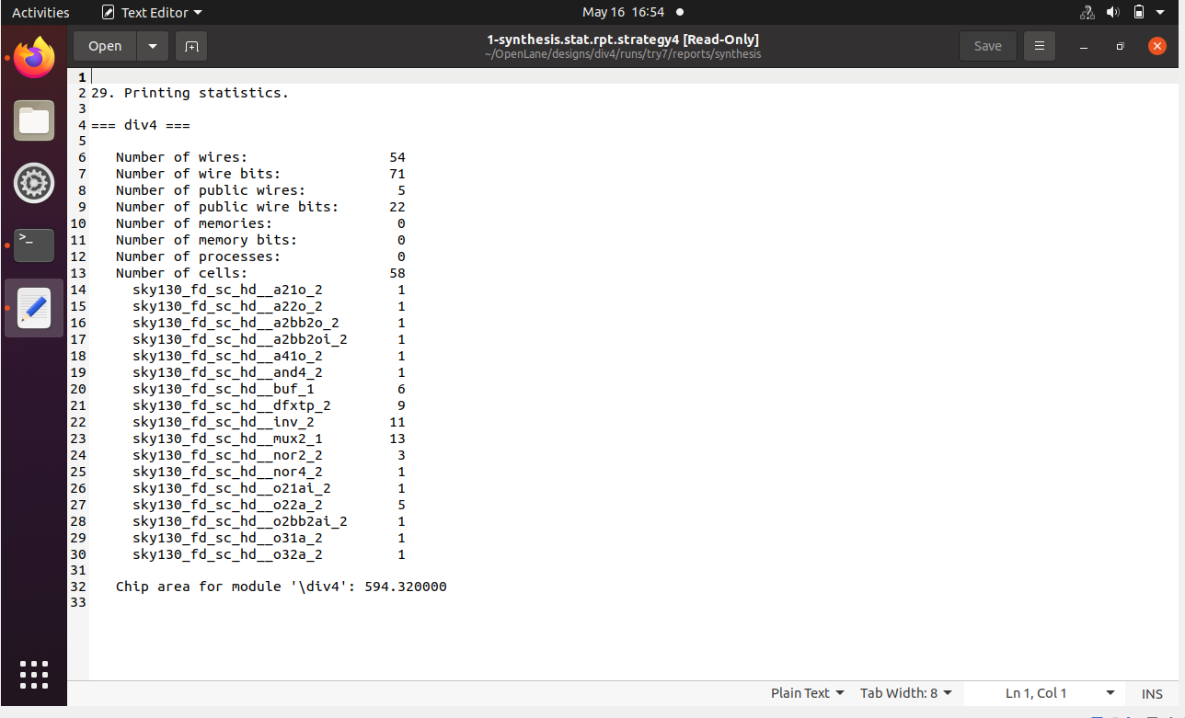
Synthesis (statistics report) – div4

Slide 33
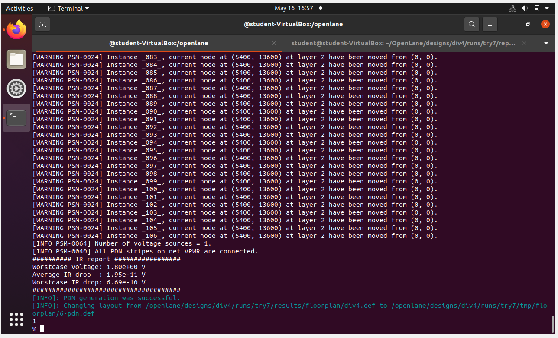
Floorplan – div4

Slide 34
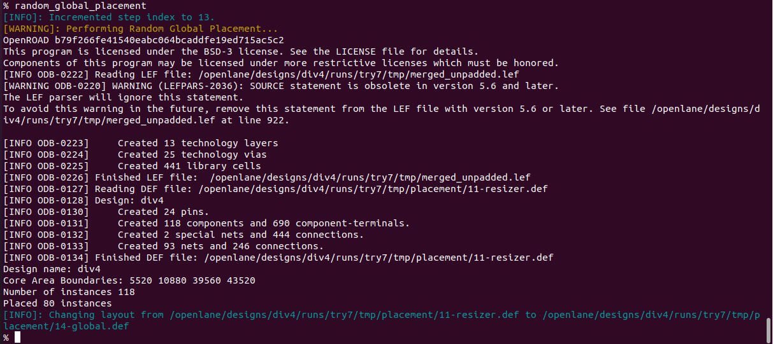
Placement – div4

Slide 35
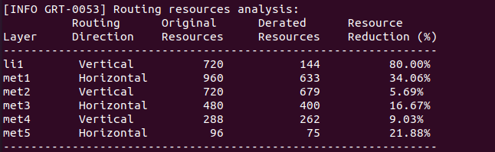
Routing – div4

Slide 36
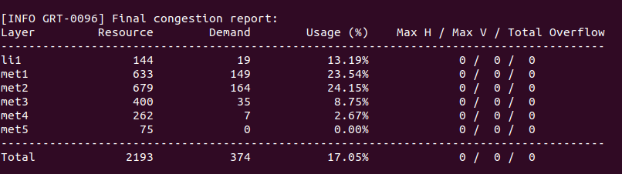
Routing – div4 contd..

Slide 37
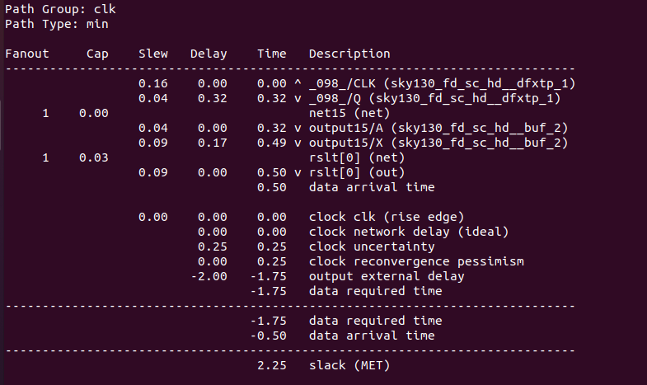
Routing – div4 contd..

Slide 38
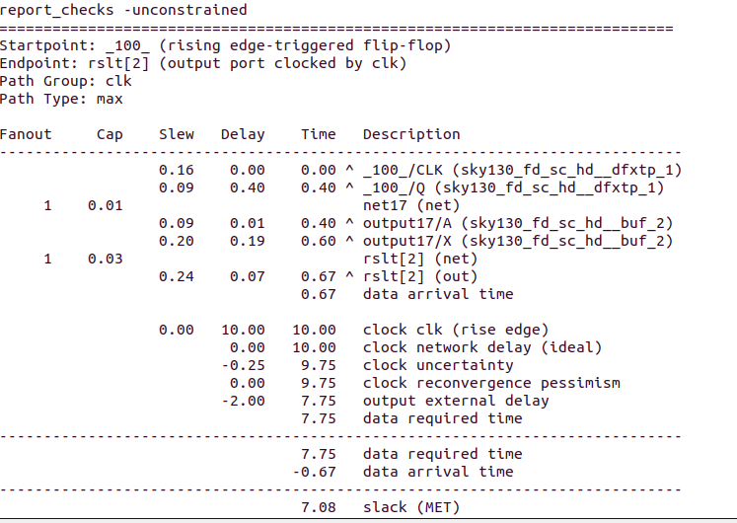
Routing – div4 contd..

Slide 39
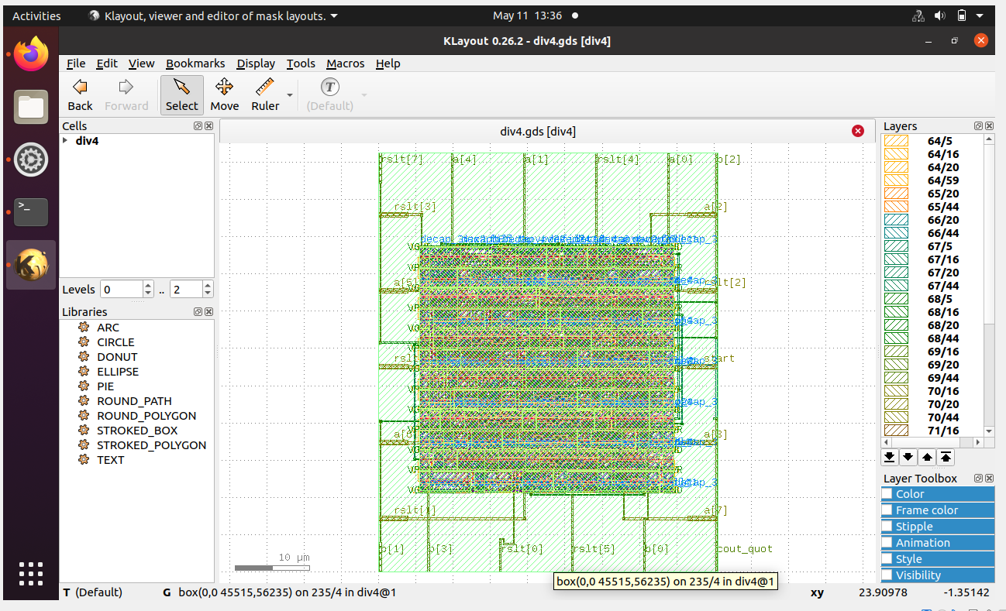
GDS – div4

Slide 40
CONCLUSION
We have successfully completed design part of our project i.e; gate level synthesis and obtained chip area required and obtained delay by performing Static Timing Analysis using STA and also obtained power report for power statistics.
We have successfully completed the backend design and obtained the GDS file.

Slide 41
THANK YOU

